Slide 1



IoT Tech Training – Module One
Guomin Huang | guhuang@microsoft.com

Slide 2
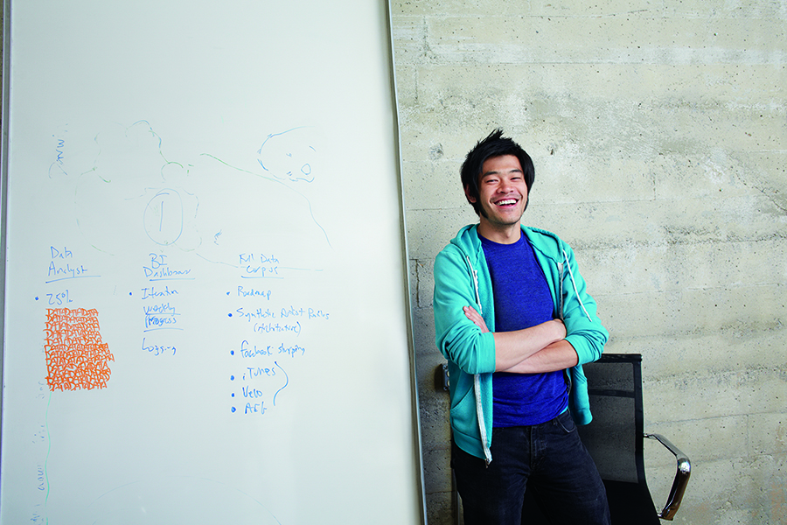



Welcome and overview

Slide 3
A little about me
China based.
Partner Technical Consultant
Lead software developer before joining Microsoft
Azure PaaS dev focused, especially in Web/Big data/ Intelligence/IoT services

Slide 4
Who are you?
Go around the room and have people introduce themselves
Name
Role in their organization
What do the expect from today’s training?

Slide 5
Introduction
Class hours
9:00 A.M. to 5:00 P.M.
Facilities
Restrooms
Exits
Meals and breaks
11:00AM & ~3:00PM – Breaks
12:00 ~13:15PM – Lunch
Internet connectivity
MSFTOPEN

Slide 6
Agenda
9:00 | 11:00 | Module 1
11:00 | 11:15 | Break
11:15 | 12:00 | Hands on Lab 1
12:00 | 13:15 | Lunch
13:15 | 14:15 | Module 2 – Part 1
14:15 | 15:00 | Hands-on Lab 2
15:00 | 15:15 | Break
15:15 | 4:00 | Module 2 – Part 2
4:00 | 5:00 | Hands-on Lab 3 & Wrap up

Slide 7

Agenda
Materials
Opportunities & Challenges
IoT Devices & Cloud Patterns
IoT Related Azure Offerings
IoT Suite
Case Studies

Slide 8
Materials
Materials download:
https://github.com/hguomin/iotworkshop161213
Get Azure Promo Code
https://mpnesp.learnondemand.net/
Training key: 167BE81D
Apply Azure subscription with promo code https://github.com/hguomin/iotworkshop161213/blob/master/Redemption%20Process.pptx
Lab environments:
Visual Studio 2015 Update3
Azure SDK
Power BI Account
Notes:
Get attendees hands on quickly to make it ‘real’
We’ve prepared lab content for attendees to use, so they can start working with the Azure IoT services (in a hands-on fashion) throughout the day.

Slide 9


Opportunities & Challenges

Slide 10
IoT is an Inflection Point
Hardware
is cheap
Connectivity
is pervasive
Development
is easy
Cloud can deal with big data
New Innovative Scenarios

Slide 11
IoT 2010
Alarm clock
Refrigerator
Automobile
VoIP phone
Computer
Printer
Media player
Microwave
HOME
WORKPLACE
HOME
Coffee maker
Smart scale
Oven
Cell phone
HVAC
Vending
Security
Television

Slide 12
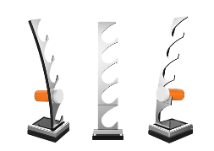
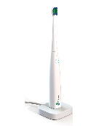
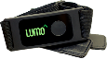
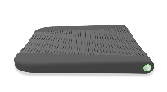
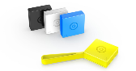
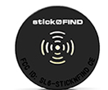


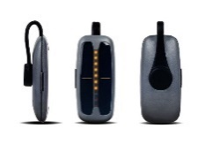
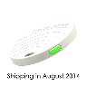
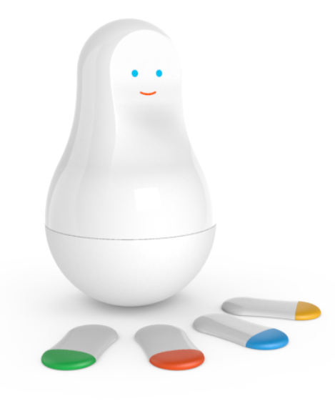
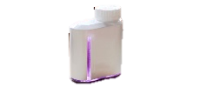

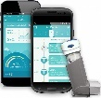
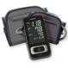
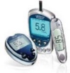
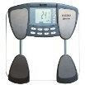
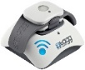
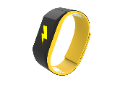
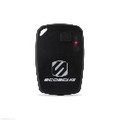
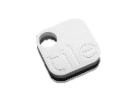
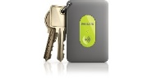
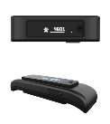



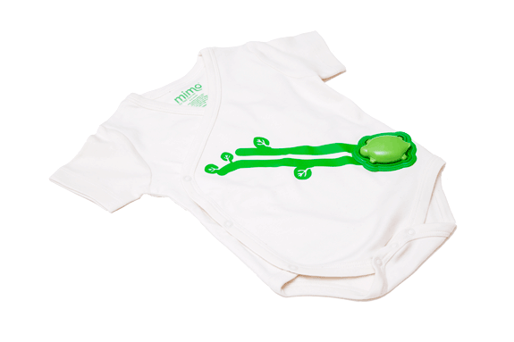
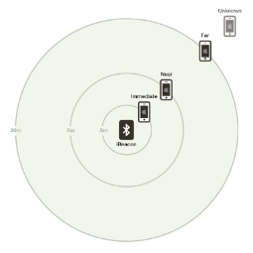
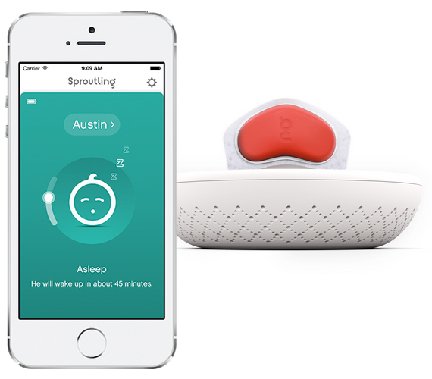


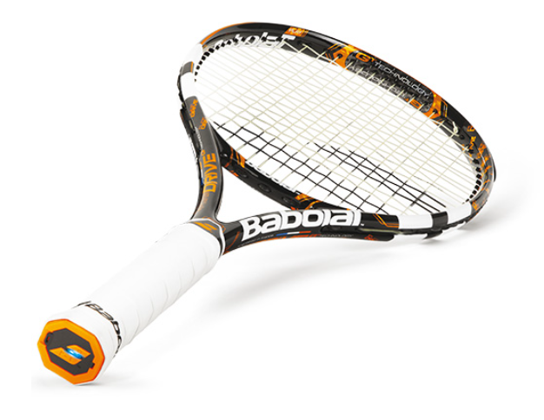
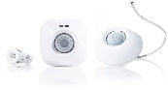
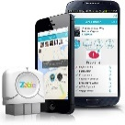
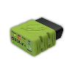
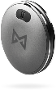
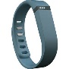
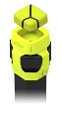
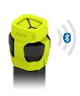
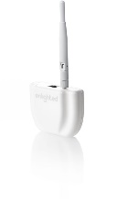
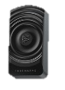


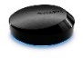
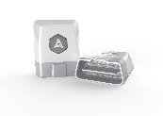
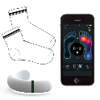
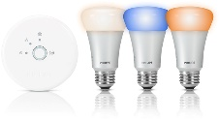
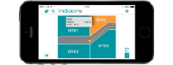
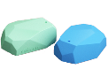
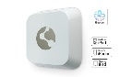
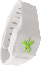
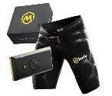
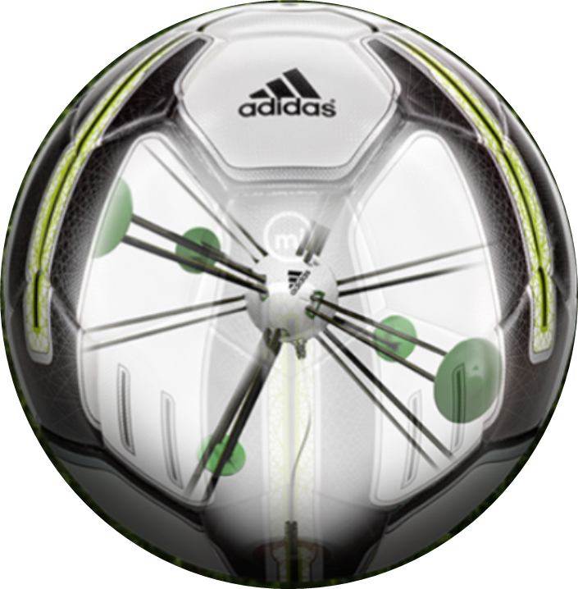


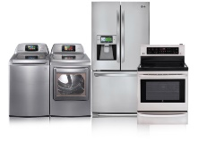
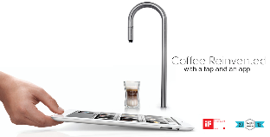
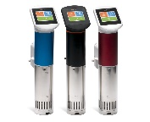
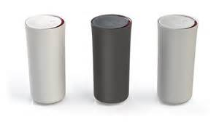
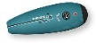
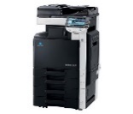










































IoT 2016
Medication adherence
Health monitoring
Pet tracking
Behavior modification
Object tracking
Child and elder monitoring
Sports and fitness
Indoor navigation
Trip tracking and car health
Smart lighting
Beacons and proximity
COMMUTE
COMMUTE
HOME
WORKPLACE
HOME
Smart appliances
Food and nutrition tracking
Identity
Office equipment
Smart vending machines
Bike ride stats and protection
Air conditioning and temperature control
Sleep tracking
Environmental sensors
Information capture
Control
Home security
Home automation
Leak detection
Garden, lawn and plant care
New devices and sensors
Entertainment systems

Slide 13

25 BILLION Connected “things” will be in use by 2020
$7.2 TRILLION worldwide market for IoT solutions by 2020
IDC: Worldwide and Regional Internet of Things (IoT) 2014–2020 Forecast
Gartner

Slide 14

Disruptive Forces
Moore’s Law
Metcalf‘s Law
Koomey’s Law
Transistors
Computations
per KWh
10,000,000,000
1.E+14
1,000,000,000
1.E+12
100,000,000
1.E+10
10,000,000
1.E+08
1,000,000
1.E+06
100,000
1.E+04
10,000
1.E+02
1,000
1.E+00
1970
1980
1990
2000
2010
1940
1975
2010
And more importantly:
what can you do by combining and analyzing signals from all of these IoT devices?

Slide 15
IoT Business Maturity Model 1. Operational efficiency
Connect devices and monitor telemetry
Monitor and track device state, location and health
Things
Rules and alerting to improve operational efficiency

Slide 16
IoT Business Maturity Model 2. Business Intelligence
Analyze and visualize data from devices
Discover patterns in device data using predictive analytics
Things
Operationalize insights to improve things and processes in real time

Slide 17
IoT Business Maturity Model 3. Business Transformation
Combine IoT & other data with advanced analytics to power new services and revenue streams
Expand into new adjacent businesses
Things
New partnership opportunities

Slide 18







IT / OT Collaboration
Operational Technology (OT)
Information Technology (IT)

Slide 19
IT / OT Collaboration Enables IoT
Enterprise

Slide 20
Collaboration & Cyberphysical Security
IT Engineers
OT Engineers
Know how to make digital things secure.
Secure Development Lifecycle
Secure Network Technologies
Threat & Vulnerability Mitigation
Monitoring and Alerting
Software/Firmware Auto-Updates
Privacy Models
Know how to make physical things safe and secure
Standards, Procedures, Training, Continuous Improvement
Physical access management
Hazard and Risk Analysis
Monitoring and Maintenance
Fail Safe and Safety Equipment
IT and OT engineers will collaborate in making “cyberphysical” systems safe and secure.

Slide 21
IoT Devices & Cloud Patterns

Slide 22
Cloud Based IoT Solutions
Azure IoT
Easy to provision, use and manage
Pay as you go, scale as you need
Global reach, hyper scale
End to end security & privacy
Three parts of an IoT solution
1 | Device connectivity & management
2 | Analytics & operationalized insights
3 | Presentation & business connectivity

Slide 23
IoT Device & Cloud Patterns
Cloud Gateway
Event/IoT Hubs
Event Hubs
High scale telemetry ingestion service
HTTP/AMQP protocol support
Each Event Hub supports
1 million publishers
1GB/s ingress
Generally available worldwide
Tens of Billions of messages per day
Tens of TB ingested per day
And rising…
Devices
RTOS, Linux, Windows, Android, iOS

Slide 24
IoT Device & Cloud Patterns
Cloud Gateway
Event Hubs
&
Azure IoT Hub
Additional IoT Needs
Command & control
Device identity
Device registry
Device and State management
Protocol translation and gateways
Protocol Adaptation
Field Gateway
Protocol Adaptation
Devices
RTOS, Linux, Windows, Android, iOS
Field Gateway
Device
Connectivity & Management

Slide 25
IoT Device & Cloud Patterns
Azure IoT Hub
Bi-directional device <-> cloud
Up to 10 million devices
Telemetry ingestion
Command & control
Device registry & identity
Bulk import/export of device identities
Device Management
HTTP/AMQP/AMQP-WS/MQTT
Extensible protocol support
Operations Monitoring
Cloud Gateway
Azure IoT Hub
Protocol Adaptation
Field Gateway
Protocol Adaptation
Devices
RTOS, Linux, Windows, Android, iOS
Field Gateway
Device
Connectivity & Management

Slide 26
IoT Device & Cloud Patterns
Cloud Gateway
Event Hubs
&
Azure IoT Hub
Cross-Platform
Device Support
Open source “agent” framework
Simple, secure device <-> cloud connectivity & management
RTOS, Linux, Windows, Android, iOS
Easy to use, not required
Protocol Adaptation
Field Gateway
Protocol Adaptation
Devices
RTOS, Linux, Windows, Android, iOS
Field Gateway
C API
.NET API
Java API
Javascript API
Cross Platform C Code
Device
Connectivity & Management
OS Abstraction Layer / OS Bindings

Slide 27





IoT Device & Cloud Patterns
Batch Analytics & Visualizations
Azure HDInsight, AzureML, Power BI,
Azure Data Factory, Azure Data Lake
Cloud Gateway
Event Hubs
&
Azure IoT Hub
Hot Path Analytics
Azure Stream Analytics, Azure HDInsight Storm
Protocol Adaptation
Hot Path Business Logic
Service Fabric & Actor Framework
Operationalize your insights in real time
Field Gateway
Protocol Adaptation
Devices
RTOS, Linux, Windows, Android, iOS
Find insights to
Power new services
Improve your “things”
IoT Scale
Object Models & Business Logic
Field Gateway
Device
Connectivity & Management
Analytics &
Operationalized Insights

Slide 28

IoT Device & Cloud Patterns
Batch Analytics & Visualizations
Azure HDInsight, AzureML, Power BI,
Azure Data Factory, Azure Data Lake
Cloud Gateway
Event Hubs
&
Azure IoT Hub
Hot Path Analytics
Azure Stream Analytics, Azure HDInsight Storm
Presentation &
Business Connectivity
App Service, Websites
Dynamics, BizTalk Services, Notification Hubs, Logic Apps
Protocol Adaptation
Hot Path Business Logic
Service Fabric & Actor Framework
Field Gateway
Protocol Adaptation
Devices
RTOS, Linux, Windows, Android, iOS
Field Gateway
Device
Connectivity & Management
Analytics &
Operationalized Insights
Presentation &
Business Connectivity

Slide 29
IoT Related Azure Offerings

Slide 30
Azure IoT Reference Architecture
Devices and Data Sources
Data Transport
Device and Event Processing
Presentation
Cloud Gate-way
Data Visualization & Presentation
IP capable devices
Provisioning API
Solution Portal
Device State Store
Agent Libs
Identity & Registry Stores
Existing IoT devices
Stream Event Processor
Agent Libs
Gateway
Storage
Analytics/ Machine Learning
Low power devices
Agent Libs
Control System Worker Role

Slide 31
















Microsoft Azure IoT services
Devices | Device Connectivity | Storage | Analytics | Presentation & Action
 | Event Hubs | SQL Database | Machine Learning | App Service
 | IoT Hubs | Table/Blob Storage | Stream Analytics | Power BI
 | Service Bus | DocumentDB | HDInsight | Notification Hubs
 | External Data Sources | External Data Sources | Data Factory | Mobile Services
 |  |  |  | BizTalk Services
{ }

Slide 32
Azure IoT Reference Architecture
Devices and Data Sources
Data Transport
Device and Event Processing
Presentation
Cloud Gate-way
Data Visualization & Presentation
IP capable devices
Provisioning API
Solution Portal
Device State Store
Agent Libs
Identity & Registry Stores
{ }
Existing IoT devices
Stream Event Processor
Agent Libs
Gateway
Storage
Analytics/ Machine Learning
Low power devices
Agent Libs
Control System Worker Role

Slide 33
Microsoft Azure IoT Suite

Slide 34
Microsoft Azure IoT Suite
Connect and scale
with efficiency
Analyze and act
on new data
Integrate and transform
business processes
Preconfigured solutions
Event processing
Workflow integration
Heterogeneous agents
Predictive analytics
Push and broadcast notifications
Connect and control
Data visualization
ID and access management

Slide 35








Microsoft Azure IoT Suite
Accelerate your business transformation
Azure IoT services
Azure IoT Suite
Enables you to
Connect assets
Mine data
Take action
Addresses
common scenarios:
Monitoring
Remote Monitoring
Predictive Maintenance
And more…

Slide 36



Accelerate time to value with preconfigured solutions
Start quickly with preconfigured solutions
Finish with your Internet of Things application
Get started in minutes
Fine-tuned to specific assets and processes
Modify existing rules and alerts
Highly visual for your real-time operational data
Add your devices and begin tailor to your needs
Integrate with back-end systems

Slide 37
IoT Suite Components & Structure

Slide 38

Solution #1: Remote Monitoring
Connect and monitor your devices to analyze untapped data and improve business outcomes by automating processes
Supports telemetry, C&C, rules/alerting, data viz., basic device registration

Slide 39
What you get with remote monitoring preconfigured solution
Azure IoT Suite Remote Monitoring
Web/Mobile App
Power BI
Devices
Back end systems and processes
Storage blobs
DocumentDB
C# simulator
IoT Hub
Stream Analytics
Event Hub
Web Jobs
Logic Apps
Azure
Active Directory

Slide 40
Components
Azure IoT Suite Remote Monitoring
Gateway: device connection point
Cold analytics: raw data
Hot analytics: summarized data
Commands: C2D requests
Actions: business logic
Registry: identity + device
Web/Mobile App
Power BI
Storage blobs
DocumentDB
IoT Hub
Stream Analytics
Event Hub
Web Jobs
Logic Apps
Azure
Active Directory

Slide 41
Data
Rules Thresholds
Telemetry Summary
Avg, Min, Max
IoT Hub
Azure Stream Analytics
Telemetry
Telemetry Job
Raw Data
Web Application
C# simulator
Dashboard
Device Info
Rules Job
Telemetry
Event Hub
Alarms
Device Info Job
Device Manager
Commands
Web Job
Telemetry
Rules
Device Info
C&C
Event Hub
Event Processor
Document DB
C# Simulator
Device Registry

Slide 42
Security
Azure IoT Suite Remote Monitoring
Device: unique SAS to sign messages, over TLS
Users: federated authentication via Azure Active Directory
Services: key-based auth
Platform (ARM): AAD + RBAC
Web/Mobile App
Power BI
Storage blobs
DocumentDB
IoT Hub
Stream Analytics
Event Hub
Web Jobs
Logic Apps
Azure
Active Directory

Slide 43

Integrate – business processes
Azure IoT Suite Remote Monitoring
Logic Apps: WYSIWYG integration
Azure (Service Bus, Blob, …)
Office (incl. Dynamics)
SalesForce CRM
BizTalk (X12, EDIFACT, AS2, …)
And more (custom, FTP, Twilio)
Functions: event-driven compute on demand
Web Jobs + Event Hubs: listen to near-raw event stream
Web/Mobile App
Power BI
Storage blobs
DocumentDB
IoT Hub
Stream Analytics
Event Hub
Web Jobs
Logic Apps
Azure
Active Directory
Functions

Slide 44

Integrate – data insight
Azure IoT Suite Remote Monitoring
SQL Data Warehouse: read via PolyBase or ingest
HDInsight: analyze in Hive, HBase, Spark; process in Storm
Data Lake (+ Analytics): store beyond the bounds of a single storage account; analyze big data on demand with USQL
Data Factory: ETL for the cloud where direct connect not available
Machine Learning: batch & real-time predictions
Web/Mobile App
Power BI
Storage blobs
DocumentDB
IoT Hub
Stream Analytics
Event Hub
Web Jobs
Logic Apps
Azure
Active Directory
SQL DW
HDInsight
Data Lake
ADF
ML

Slide 45

Solution #2: Predictive Maintenance
Anticipate maintenance needs and avoid unscheduled downtime by connecting and monitoring your devices for predictive maintenance

Slide 46
Architectural Differences
Added
Machine Learning: model, real-time predictions
Portal: simulation data visualization
Removed
Device Registry: fixed set of simulated sensors only
Rules & Alerts: all data passed to ML for analysis

Slide 47
Hands on Lab 1

Slide 48
Preconfigured Solutions - Support
GitHub
Multiple projects available
Can make pull requests and report bugs
https://github.com/Azure
Azure IoT Documentation
Introductory content and video tutorials
https://azure.microsoft.com/en-us/documentation/services/iot-hub/
MSDN
Post questions on the Azure Forum
Stack Overflow
Tag Questions with the keyword “Azure IoT”

Slide 49
Planning

Slide 50
Scale
Data Ingest
IoT Hub
6M 4KB msgs per day
ASA
1 MB/s unit
Event Hub
1 MB/s unit in, 2MB/s unit out
Web Jobs
Instance
Data Egress
Web
Instance
IoT Hub
6M 4KB msgs per day
+ automated actions

Slide 51
Pricing
Service | Measure | Monthly Price | Notes
IoT Hub | 6M msgs/day; ~24GB | $500/unit | Smaller unit size available; up to 200 units
Stream Analytics | 1 MB/s per unit + per GB processed | $22.30/unit (3) + $0.001/GB
Event Hubs | 1 MB/s ingress & 2 MB/s egress per unit + per message received | $22/unit + $0.028/million ingress events | Smaller unit size available
Storage | Per GB | $0.024 - $0.061/GB
App Service | Per instance | S1 = $74 (x2) P1 = $223 (x2)
DocumentDB | Per collection | S1 = $25
TOTAL (NO ACTIVITY) |  | $1,190 | ~$40/day
TOTAL (6M msgs/day) |  | $1,225 | ~$41/day

Slide 52
Case Studies

Slide 53


The connected cow: Using IoT to transform cattle production
CHALLENGE
SOLUTION
BENEFITS
Fujitsu is the world’s fourth-largest IT services provider with approximately 162,000 employees in more than 100 countries and holds about 97,000 patents worldwide. Fujitsu wanted to help dairy farmers increase production, improve data insights and transform their business by optimizing the timing of artificial insemination (AI). It also wanted to decrease loss through early detection of health issues.
Fujitsu learned from public research that a cow produces more estrus (goes into heat) 16 hours after the number of steps increases significantly. The company created an innovative solution which uses a rugged pedometer with a five-year battery to measure the number of footsteps a cow takes, then sends that data to the cloud for analysis to determine optimum AI timing and even affect calf gender. In addition, the patterns of steps can detect disease in cattle. Alerts are delivered to the farmer’s cell phone.
Improves calf production up to 31%, with an average of 12%
Modernizes data access with mobile phone alerts, reducing labor costs for monitoring cows
Transforms herd management by allowing farmers to increase chances of producing a male or female calf
Reduces loss by detecting 8-10 different kinds of diseases in cattle
FUJITSU

Slide 54

© 2013 Microsoft Corporation. All rights reserved. Microsoft, Windows, Windows Vista and other product names are or may be registered trademarks and/or trademarks in the U.S. and/or other countries.
The information herein is for informational purposes only and represents the current view of Microsoft Corporation as of the date of this presentation. Because Microsoft must respond to changing market conditions, it should not be interpreted to be a commitment on the part of Microsoft, and Microsoft cannot guarantee the accuracy of any information provided after the date of this presentation. MICROSOFT MAKES NO WARRANTIES, EXPRESS, IMPLIED OR STATUTORY, AS TO THE INFORMATION IN THIS PRESENTATION.

